Slide 1
Text Classification
Based on slides by Rada Mihalcea

Slide 2
Is this spam?
From: "" <takworlld@hotmail.com>
Subject: real estate is the only way... gem oalvgkay
Anyone can buy real estate with no money down
Stop paying rent TODAY !
There is no need to spend hundreds or even thousands for similar courses
I am 22 years old and I have already purchased 6 properties using the
methods outlined in this truly INCREDIBLE ebook.
Change your life NOW !
=================================================
Click Below to order:
http://www.wholesaledaily.com/sales/nmd.htm
=================================================

Slide 3
Categorization/Classification
Given:
  A description of an instance, x∈X, where X is the instance language or instance space.
    Issue: how to represent text documents.
  A fixed set of categories:
  C = {c₁, c₂,…, c_{n}}
Determine:
  The category of x: c(x)∈C, where c(x) is a categorization function whose domain is X and whose range is C.
    We want to know how to build categorization functions (“classifiers”).

Slide 4
Document Classification
“planning
language
proof
intelligence”
Testing
Data:
(AI)
(Programming)
(HCI)
Classes:
ML
Planning
Semantics
Garb.Coll.
Multimedia
GUI
Training
Data:
learning
intelligence
algorithm
reinforcement
network...
planning
temporal
reasoning
plan
language...
programming
semantics
language
proof...
garbage
collection
memory
optimization
region...
...
...
(Note: in real life there is often a hierarchy, not present in the above problem statement; and you get papers on ML approaches to Garb. Coll.)

Slide 5
Text Categorization Examples
Assign labels to each document or web-page:
Labels are most often topics such as Yahoo-categories
e.g., "finance," "sports," "news>world>asia>business"
Labels may be genres
e.g., "editorials" "movie-reviews" "news“
Labels may be opinion
e.g., “like”, “hate”, “neutral”
Labels may be domain-specific binary
e.g., "interesting-to-me" : "not-interesting-to-me”
e.g., “spam” : “not-spam”
e.g., “is a toner cartridge ad” :“isn’t”

Slide 6
Methods (1)
Manual classification
  Used by Yahoo!, Looksmart, about.com, ODP, Medline
  very accurate when job is done by experts
  consistent when the problem size and team is small
  difficult and expensive to scale
Automatic document classification
  Hand-coded rule-based systems
    Used by CS dept’s spam filter, Reuters, CIA, Verity, …
    E.g., assign category if document contains a given boolean combination of words

Slide 7
Methods (2)
    Accuracy is often very high if a query has been carefully refined over time by a subject expert
    Building and maintaining these queries is expensive
Supervised learning of document-label assignment function
  Many new systems rely on machine learning (Autonomy, Kana, MSN, Verity, …)
    k-Nearest Neighbors (simple, powerful)
    Naive Bayes (simple, common method)
    Support-vector machines (new, more powerful)
    … plus many other methods
    No free lunch: requires hand-classified training data
    But can be built (and refined) by non-experts

Slide 8
Text Categorization: attributes
Representations of text are very high dimensional (one feature for each word).
High-bias algorithms that prevent overfitting in high-dimensional space are best.
For most text categorization tasks, there are many irrelevant and many relevant features.
Methods that combine evidence from many or all features (e.g. naive Bayes, kNN, neural-nets) tend to work better than ones that try to isolate just a few relevant features (standard decision-tree or rule induction)*
*Although one can compensate by using many rules
Notes:
Explain supervised learning

Slide 9
Bayesian Methods
Learning and classification methods based on probability theory.
Bayes theorem plays a critical role in probabilistic learning and classification.
Build a generative model that approximates how data is produced
Uses prior probability of each category given no information about an item.
Categorization produces a posterior probability distribution over the possible categories given a description of an item.

Slide 10
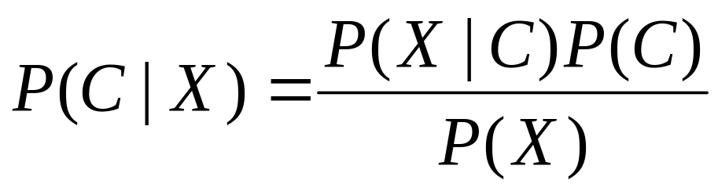
Bayes’ Rule

Slide 11
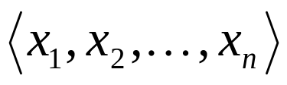
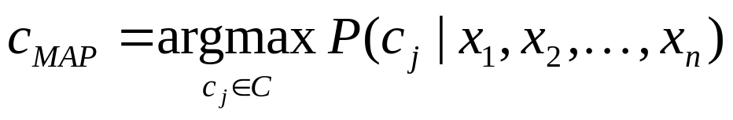
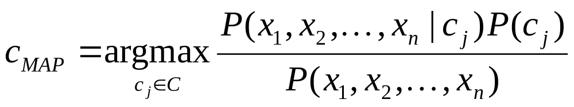
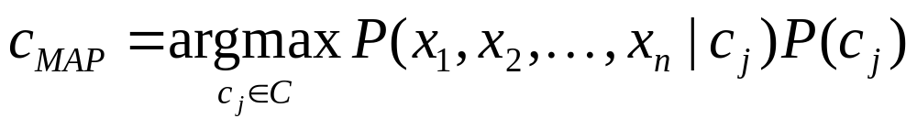
Naive Bayes Classifiers
Task: Classify a new instance based on a tuple of attribute values

Slide 12
Naïve Bayes Classifier: Assumptions
P(c_{j})
  Can be estimated from the frequency of classes in the training examples.
P(x₁,x₂,…,x_{n}|c_{j})
  O(|X|^{n}•|C|)
  Could only be estimated if a very, very large number of training examples was available.
Conditional Independence Assumption:
⇒ Assume that the probability of observing the conjunction of attributes is equal to the product of the individual probabilities.

Slide 13
The Naïve Bayes Classifier
Flu
X₁
X₂
X₃
X₄
X₅
runnynose
sinus
cough
fever
muscle-ache
Conditional Independence Assumption: features are independent of each other given the class:

Slide 14
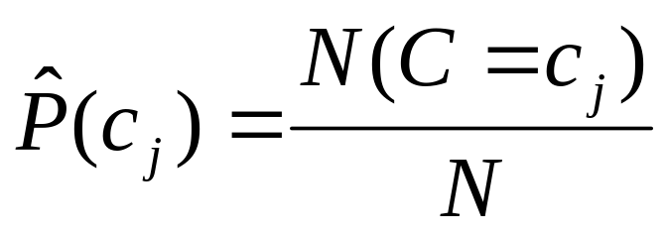
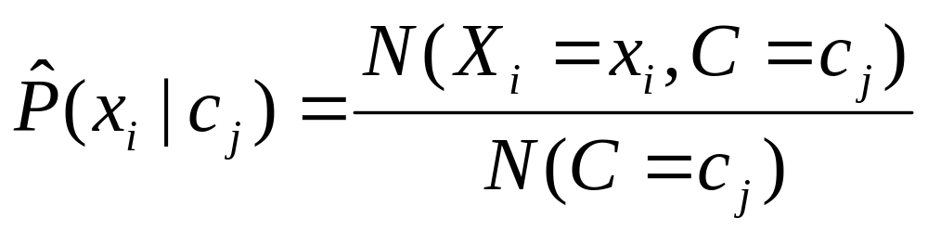
Learning the Model
C
X₁
X₂
X₃
X₄
X₅
X₆
Common practice:maximum likelihood
  simply use the frequencies in the data

Slide 15
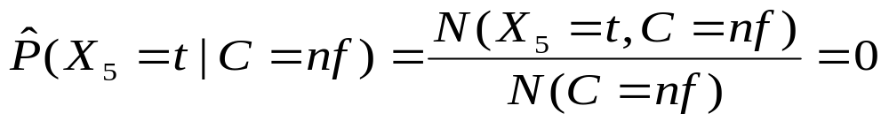
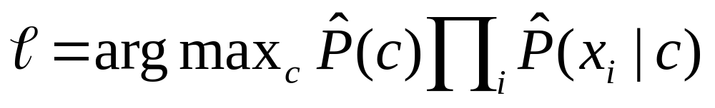
Problem with Max Likelihood
Flu
X₁
X₂
X₃
X₄
X₅
runnynose
sinus
cough
fever
muscle-ache
What if we have seen no training cases where patient had no flu and muscle aches?
Zero probabilities cannot be conditioned away, no matter the other evidence!

Slide 16
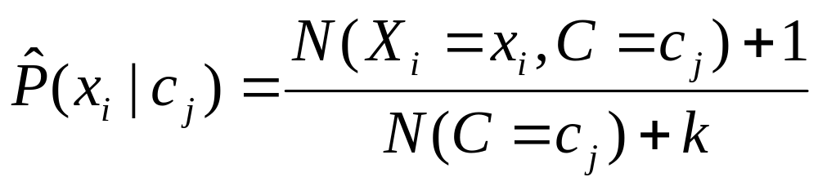
Smoothing to Avoid Overfitting
# of values of X_{i}

Slide 17
Underflow Prevention
Multiplying lots of probabilities, which are between 0 and 1 by definition, can result in floating-point underflow.
Since log(xy) = log(x) + log(y), it is better to perform all computations by summing logs of probabilities rather than multiplying probabilities.

Slide 18
Evaluating Categorization
Evaluation must be done on test data that are independent of the training data (usually a disjoint set of instances).
Classification accuracy: c/n where n is the total number of test instances and c is the number of test instances correctly classified by the system.
Results can vary based on sampling error due to different training and test sets.
Average results over multiple training and test sets (splits of the overall data) for the best results.

Slide 19
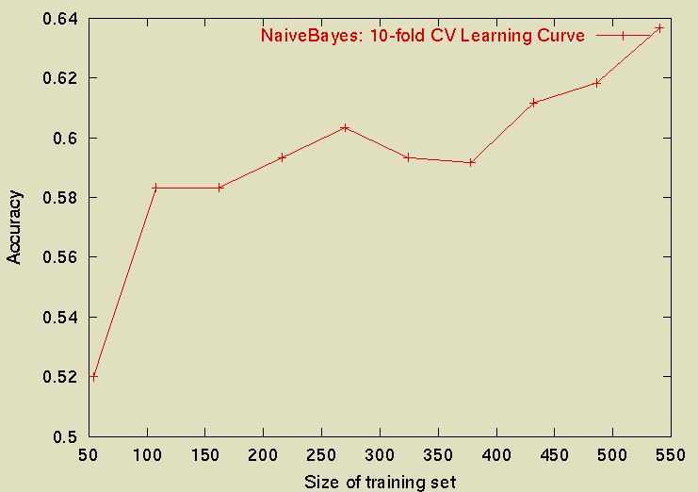
Sample Learning Curve
(Yahoo Science Data)
Classify 13,000 web pages under the Yahoo! Science directory

